Slide 1
Introduction to PHP

Slide 2
Objectives
In this chapter, you will learn:
  To understand a Web server’s functionality.
  To introduce Microsoft Internet Information Services (IIS) and Apache Web server.
  To learn how to request documents from a Web server.
  To understand PHP data types, operators, arrays and control structures.
  To understand string processing and regular expressions in PHP.
  To construct programs that process form data.
  To be able to read and write client data using cookies.
  To construct programs that interact with MySQL databases.

Slide 3
Introduction
Web server
  Responds to client requests by providing resources
URI (Uniform Resource Identifier)
Web server and client communicate with platform-independent Hypertext Transfer Protocol (HTTP)

Slide 4
HTTP Request Types
Request methods
  Get - Retrieve and send client form data to Web server
    Common uses: to retrieve an HTML document or an image or to fetch search results based on a user-submitted search item
  Post - Post data to a server-side form handler
    Common uses: to send information to a server, such as authentication information or data from a form that gathers user input

Slide 5
System Architecture
Multi-tier application (n-tier application)
  Information tier (data or bottom tier)
    Maintains data for the application
    Stores data in a relational database management system (RDBMS)
  Client tier (top tier)
    Application’s user interface
    Users interact directly with the application through the client tier

Slide 6
Multi-tier application (n-tier application)
  Middle tier
    Implements business logic and presentation logic
    Control interactions between application clients and application data
      The Controller Logic processes client requests from the top-tier and retrieves data from the database
      The Presentation Logic then processes data from the information tier and presents the content to the client
      The business logic enforces business rules and ensures that data is reliable before updating the database or presenting the data to a user.
      Business rules dictate how clients can and cannot access application data and how applications process data.

Slide 7
Client-Side Scripting versus Server-Side Scripting
Client-side scripts
  Validate user input
    Reduce requests needed to be passed to server
    Access browser
    Enhance Web pages with Javascript,DHTML, ActiveX controls, and applets
Server-side scripts
  Executed on server
  Generate custom response for clients
  Wide range of programmatic capabilities
  Access to server-side software that extends server functionality

Slide 8
Accessing Web Servers
Request documents from Web servers
  Users must know names (Host names) on which the Web server software resides. These could be:
    Local Web servers
      Access through machine name or localhost
    Remote Web servers
      Access through machine name (domain name) that must be resolved using the Domain Name Service

Slide 9
Apache Web Server
Currently the most popular Web server because of its:
  Stability
  Efficiency
  Portability
  Security
  Small size and
  Open-source
To get access to a web server with PHP support, you can:
Install Apache (or IIS) on your own server, install PHP, and MySQL
Or find a web hosting plan with PHP and MySQL support

Slide 10

Apache Web Server
Fig. 4.13 Apache Web server starting. (Courtesy of The Apache Software Foundation.)

Slide 11
Introduction
PHP
  PHP: Hypertext Preprocessor
  Created in 1994 by Rasmus Lerdorf to tack users at his Web site
  Is a Server-side scripting language, like ASP
  PHP scripts are executed on the server
  Supports many databases (MySQL, Informix, Oracle, Sybase, Solid, PostgreSQL, Generic ODBC, etc.)
  Open-source
    Anyone may view, modify and redistribute source code
    Supported freely by community
  Platform independent
  MySQL
  is a database server ideal for both small and large applications
  It supports standard SQL
  It compiles on a number of platforms

Slide 12
PHP
Operation
  PHP was specifically written for handling the interaction with the Web;
    Enables serving content to users
    Responds to requests from users
    Generating Web pages with dynamic content
  PHP is embedded directly into XHTML documents
Basic application
  Scripting delimiters
    <? php ?>
    Must enclose all script code

Slide 13
PHP
  End statements with semicolon
  Comments
    // for single line
    /* */ for multiline
  Filenames end with .php by convention
Variables
  Can have different types at different times
  Variable names inside strings replaced by their value
  -Variables preceded by $ symbol
    Case-sensitive
    Loosely typed
  Type conversions using settype function
  Concatenation operator - . (period)

Slide 14
EXAMPLE 1
<html>
<head><title>sample php page</title></head>
<body>
<?php
print "This is a php sample page";//display statement
$sname=“Coders";
print "<br> welcome ".$sname." to my website";
print "<p><font color='red' size=18>i like prgramming</font></p>";
?>
</body></html>

Slide 15
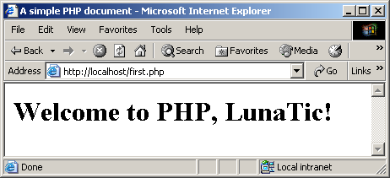
PHP
Fig. 4.1 Simple PHP program.

Slide 16
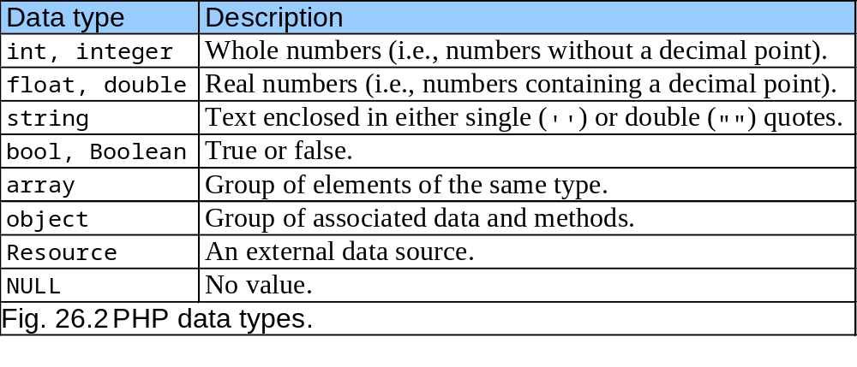
PHP

Slide 17
PHP
Arrays, cont.
  Built-in iterators
    Maintain pointer to element currently referenced
    reset
    key
    next
    foreach loops

Slide 18
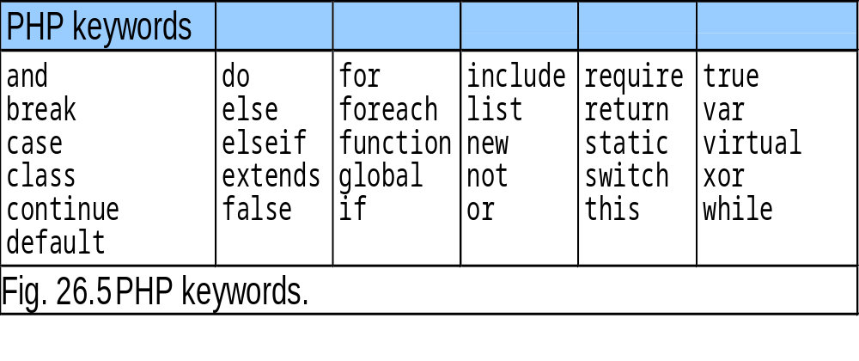
PHP

Slide 19
PHP
Keywords
  Reserved for language features
  if…elseif…else
Arrays
  Group of related data
    Elements
  Name plus braces and index
    Indices start at zero
  count function
  array function

Slide 20
Example 3
<html>
<body>
<?php echo "Hello World";
print(" <br>wooo uuu uu");
$name="ELIUD KIPCHOGE";
print($name);
if(strcmp($name,“ELIUD KIPCHOGE”)==0)
print("<br>it is ok");
else print("<br>you flopped ");
echo "<br> welcome Mr " .$name. " to my website";
?> </body> </html>

Slide 21
loop
The while loop repeats one or more statements—the loop body—as long as a condition remains true. The condition is checked first, then the loop body is executed. So, the loop never executes if the condition isn't initially true.
example
$counter = 1;
while ($counter < 11)
{
print $counter . " ";
$counter++;
}

Slide 22
FOR
The for loop statement has three parts separated by semicolons, and all parts are optional:
Initial statements
Statements that are executed once, before the loop body is executed.
Loop conditions
The conditional expression that is evaluated before each execution of the loop body. If the conditional expression evaluates as false, the loop body is not executed.
End-loop statements
Statements that are executed each time after the loop body is executed.
Example
for($counter=1; $counter<11; $counter++)
{
print $counter;
print " ";
}

Slide 23
Php Example
<html>
<head>
<title>The Times-Tables</title>
</head>
<body bgcolor="#ffffff">
<h1>The Times Tables</h1>
<?php
// Go through each table
for($table=1; $table<13; $table++)
{
print "<p><b>The " . $table . " Times Table</b>\n";
// Produce 12 lines for each table

Slide 24
continuation
for($counter=1; $counter<13; $counter++)
{
$answer = $table * $counter;
// Is this an even-number counter?
if ($counter % 2 == 0)
// Yes, so print this line in bold
print "<br><b>$counter x $table = " .
"$answer</b>";
else
// No, so print this in normal face
print "<br>$counter x $table = $answer";
}
}
?>
</body> </html>

Slide 25
ARRAYS
A PHP array is an ordered set of variables, in which each variable—called an element— has an associated key . PHP allows elements to be accessed using either string or integer keys—PHP automatically assigns integer key values if keys are not specified when arrays are constructed.
Arrays can hold scalar values (integers, Booleans, strings, or floats) or compound values (objects and even other arrays). The same array can even hold elements of different types

Slide 26
ARRAYS
$numbers = array(5, 4, 3, 2, 1);
$words = array("Web", "Database", "Applications");
// Print the third element from the array of integers: 3 print $numbers[2];
// Print the first element from the array of strings: "Web" print $words[0];
You can also create an array by assigning elements to a new, unset variable. The following code fragment illustrates the bracket syntax with an array of strings:
$newArray[0] = "Potatoes";
$newArray[1] = "Carrots";
$newArray[2] = "Spinach";

Slide 27
Form Processing and Business Logic
Form processing
  XHTML forms enable Web pages to collect data from users and send it to a Web server
  action property
    Where to send form data
  method property
    Post – appends form data to the browser request that contains the protocol (HTTP) and the requested resource’s URL.
    Server scripts can access the this data
  Each element on the form has unique name

Slide 28
PHP form example 1
<html><body>
<form action="welcome.php" method="post">
Name: <input type="text" name="fname" />
Age: <input type="text" name="age" />
<input type="submit" />
</form></body></html>
When a user fills out the form above and click on the submit button, the form data is sent to a PHP file, called “welcome.php":
<html><body>
Welcome <?php echo $_POST["fname"]; ?>!<br />
You are <?php echo $_POST["age"]; ?> years old.
</body>
</html>

Slide 29
Example 2
Create a form below and save it as myform.html
<html>
<head><title>using php on form controls</title></head>
<body>
<form action="display.php" method="post">
Enter the name of your favourite author
<input type="text" name="author" /><br />
what is your age<input type="text" size=5 name="age" /><br />
what are your favorite website?<br />
<textarea cols=30 rows=10 name="websites">
</textarea><br />
have ever eaten rat?
<input type="checkbox" name="rat"/><br />
<br />what is the capital city of Portugal?<br />
porto<input type="radio" name="city" value=“porto" /><br />
lisbon<input type="radio" name="city" value="lisbon"/><br />
madrid<input type="radio" name="city" value="madrid"/><br />
what is the price of car that you want to buy<br />?

Slide 30
Example 2 cont
<select name="price">
<option>under ksh 250,000
<option>250,000-400,000
<option>400,000-600,000
<option>over 600,000
</select>
Engine capacity :<br />
<select name="engine">
<option>1000 cc
<option>1200 cc
<option>1400 cc
<option>1500 cc
<option>1800 cc
</option>
<input type="submit" value="submit query" />
</form>
</body>
</html>

Slide 31
Php program to handle the form
<html>
<head></head>
<body>
<?php
print "The name of your favourite author is: ".$_POST['author'] ;
print "<br> Your age is ".$_POST['age'];
print "<br>your favorite websites?".$_POST['websites'];
print "<br>";
if($_POST['rat']=='on'){print "you have eaten rat atleast once in your life time <br>";}
else{print "you have never eaten rat<br>";}
print "You entered ".$_POST['city'];
if ($_POST['city'] !='lisbon')
print "<br>wrong answer, the correct answer is lisbon";
else
print "<br>That is correct";
echo " <br> Price Range is ".$_POST['price'];
print "<br>engine size:".$_POST['engine'];
?>
</body>
</html>

Slide 32
Database management
Database
  Integrated collection of data
  Database management system (DBMS)
    Store and organize data consistent with database’s format
    Relational database
      SQL (Structured Query Language)
        Queries
        Manipulate data
  The Relational Database Model
  SQL

Slide 33
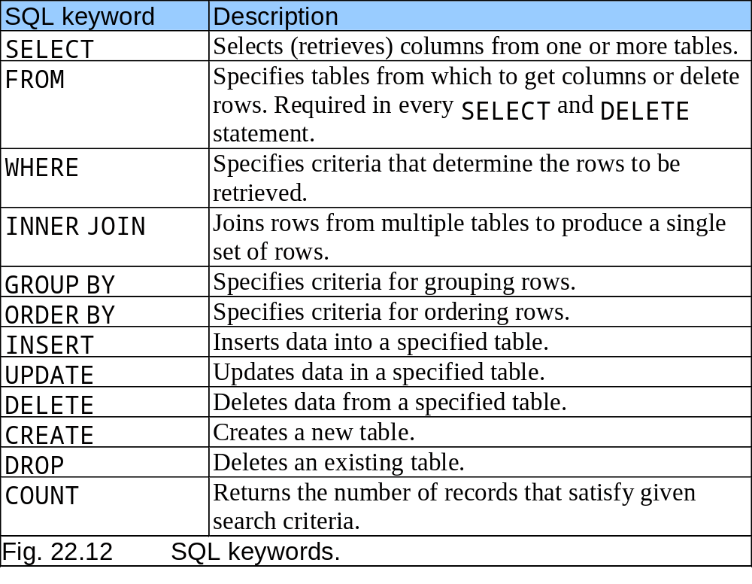
SQL (Structured Query Language)

Slide 34
MySQL
Invented by Michael Widenius of a Swedish consulting firm (TcX) in 1994
Multi-user and multi-threaded RDBMS server
Uses SQL to interact with and manipulate data
The MySQL manual can found at www.mysql/doc
Supports various programming languages (C, C++, Java, Perl, PHP, codeFusion, Python, etc)
Implementation available for Windows, Mac OS X, Linux and UNIX
Access tables from different databases using a single Query
Handle large databases; tens of thousands of tables with millions of rows
It is open-source though a commercial license is required under certain situations

Slide 35
Introduction to DBI
Databases have become a crucial part of Distributed Applications
On the other hand, relational databases (commonly used) have different implementations and drivers each with different syntax
The need to simplify the use of multiple databases resulted in Database interfaces (DBI); usually provided in form of programmatic libraries by various programming languages

Slide 36
PHP dbx module
The dbx module does not interact with a database directly; it interacts with one of the several database-specific module
Seven functions that interface to database modules for each of the following:
  MySQL
  PostgreSQL
  Microsoft SQL Server
  Oracle
  Sybase
  FrontBase
  ODBC (Open Database Connectivity)

Slide 37
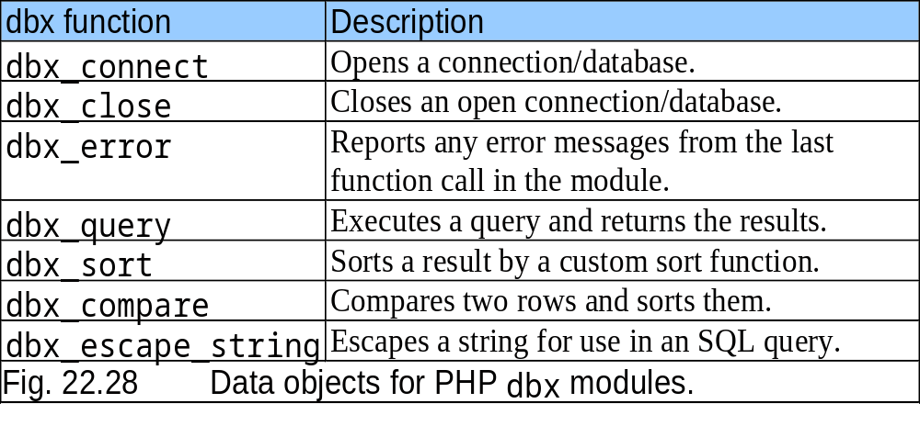
PHP dbx module

Slide 38
Connecting to a Database
Databases
  Store and maintain data
  MySQL is a free database product
  PHP supports many database operations
    Access databases from Web pages

Slide 39
Connecting to a Database
Several useful functions
    mysql_connect – to connect to the MySQL Databse; requires 3 parameters and then returns a database handle (a reference to the object that is later used in the PHP code
      The server’s host name
      A username
      A password
    mysql_select_db – to specify the database
    mysql_query – to query the database; need to specify the query String and the database to query. Can also be used to for other SQL statements such as INSERT and DELETE
    mysql_error – returns any error message from the database
    mysql_fetch_row – returns any array containing the values for each of the columns of each row
    mysql_close, mysql_num_rows;

Slide 40
MySQL
Queries.
MySQL, we can query a database for specific information and have a recordset returned.
Create a Connection to a MySQL Database
mysql_connect(servername,username,password);
<?php
$con = mysql_connect("localhost","peter","abc123");
if (!$con)
{
die('Could not connect: ' . mysql_error());
}
// some code
mysql_close($con); ?>

Slide 41
CREATING DATABASE
<?php
$con = mysql_connect("localhost","peter","abc123");
if (!$con)
{
die('Could not connect: ' . mysql_error());
}
if (mysql_query("CREATE DATABASE my_db",$con))
{
echo "Database created";
}
else
{
echo "Error creating database: " . mysql_error();
}
mysql_close($con);
?>

Slide 42
Create table query
// Create table
mysql_select_db("my_db", $con);
$sql = "CREATE TABLE Persons
(
FirstName varchar(15),
LastName varchar(15),
Age int
)";
A database must be selected before a table can be created. The database is selected with the mysql_select_db() function.
Note: When you create a database field of type varchar, you must specify the maximum length of the field, e.g. varchar(15).

Slide 43
Inserting data into the table
<?php
$con = mysql_connect("localhost","peter","abc123");
if (!$con)
{
die('Could not connect: ' . mysql_error());
}
mysql_select_db("my_db", $con);
mysql_query("INSERT INTO Persons (FirstName, LastName, Age)
VALUES ('Peter', 'Griffin', '35')");
mysql_query("INSERT INTO Persons (FirstName, LastName, Age)
VALUES ('Glenn', 'Quagmire', '33')");
mysql_close($con);
?>

Slide 44
Data from form
Create a form for data entry
<html><body>
<form action="insert.php" method="post">
Firstname: <input type="text" name="firstname" />
Lastname: <input type="text" name="lastname" />
Age: <input type="text" name="age" />
<input type="submit" />
</form></body></html>
PHP Code to accept data from the form
$sql="INSERT INTO Persons (FirstName, LastName, Age)
VALUES
('$_POST[firstname]','$_POST[lastname]','$_POST[age]')";
if (!mysql_query($sql,$con))
{
die('Error: ' . mysql_error());
}
echo "1 record added";
mysql_close($con)

Slide 45
Selecting data from Table
mysql_select_db("my_db", $con);
$result = mysql_query("SELECT * FROM Persons");
while($row = mysql_fetch_row($result))
{
echo $row['FirstName'] . " " . $row['LastName'];
echo "<br />";
}

Slide 46
More Examples
Create a form using code below.
<form action=“handler1.php" method="post">
ID <Input type="text" name="id" />
FIRST NAME<input type="text" name="fname" />
LAST NAME<input type="text" name="lname" />
<br />AGE<input type="text" name="age" />
<input type="submit" />
</form>

Slide 47
Form handler
<?php
$con=mysql_connect("localhost","root","");
if(!$con)
echo "error connecting ".mysql.error();
else
echo "it is ok.";
mysql_query("CREATE DATABASE db" ,$con);
echo "database created";
mysql_select_db("db",$con);
$sql="CREATE TABLE person( id VARCHAR(10) NOT NULL,PRIMARY KEY(id), firstname VARCHAR(20),lastname VARCHAR(20),age int )";
extract($_POST);
mysql_query($sql);
mysql_query("INSERT INTO person(id,firstname,lastname,age) VALUES('$id','$fname','$lname','$age')");
$result=mysql_query("SELECT * FROM person");
while($row=mysql_fetch_row($result))
{
echo "<br>";
echo " ".$row[0]." ".$row[1]." ".$row[2];
echo "</br>";
}
mysql_close($con); ?>

Slide 48
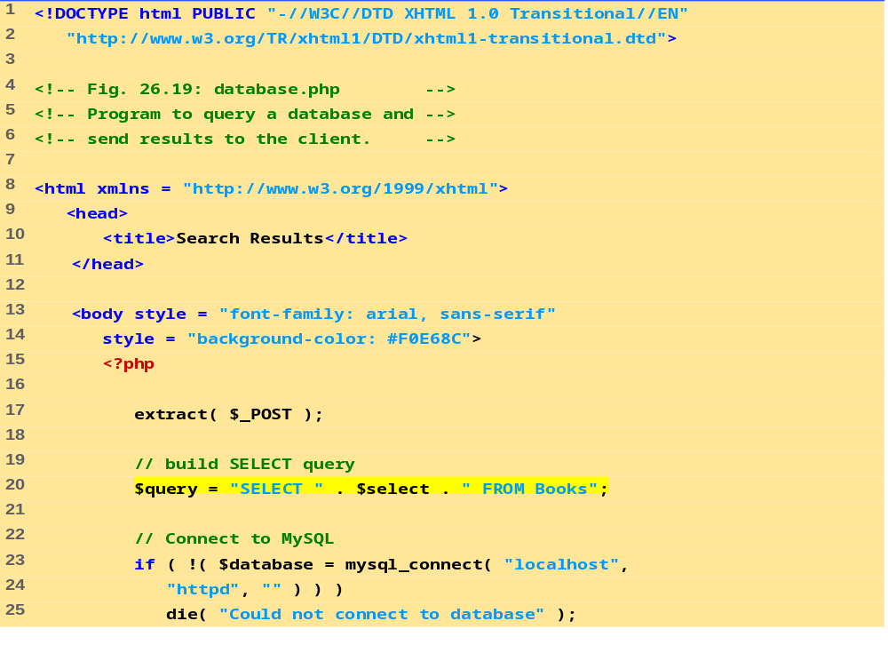
Build the select query and assign the string to variable $query.
Function mysql_connect returns a database handle which represents PHP’s connection to a database. If this connection is not made, function die is called to terminate script execution.

Slide 49
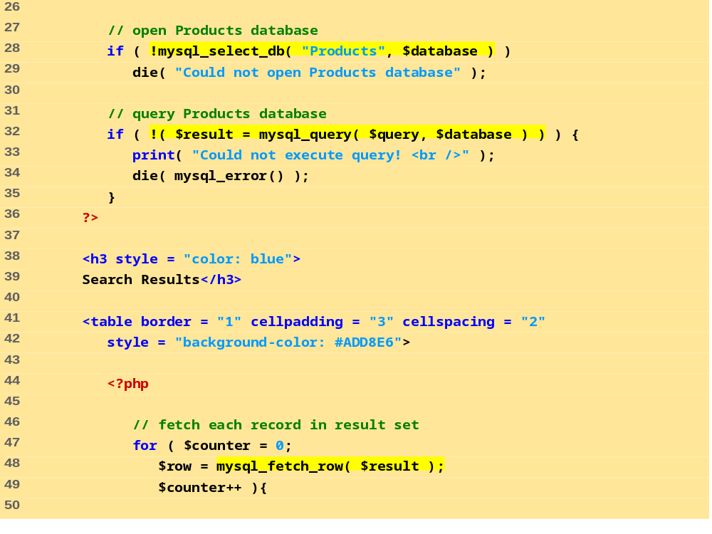
Function mysql_query returns an object containing the result set of the query, which we assign to variable $result.
Function mysql_select_db is called to specify the database to be queried.
The for loop iterates through each record in the result set while constructing an XHTML table from the results. Variable $counter is incremented by one for each row retrieved.
Function mysql_fetch_row returns an array containing the elements of each row in the result set of our query ($result).

Slide 50
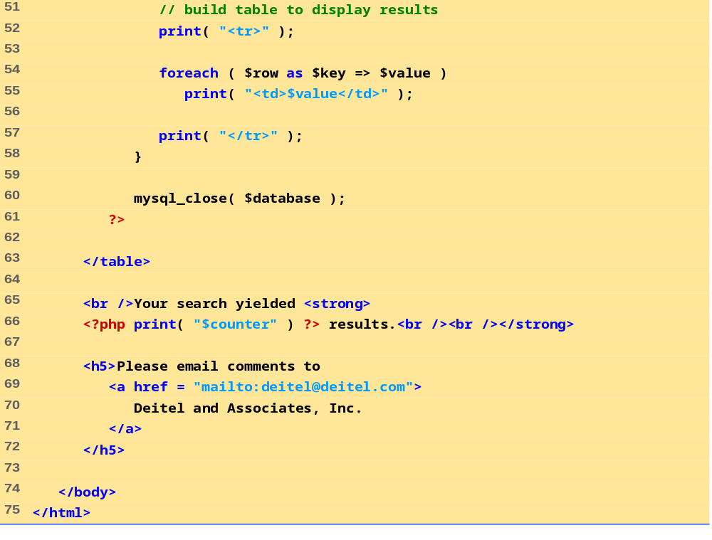
The foreach loop iterates through the array containing the elements of each row and prints out each element in an individual table cell.
The total number of results are printed to the client.

Slide 51
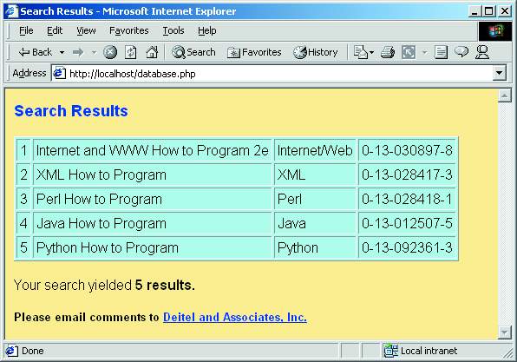
Connecting to a Database
Fig. 26.19 Querying a database and displaying the results.

Slide 52
Cookies
Cookies
  Store information on client computer
  Track preferences and other information
  Stored as text files on hard drive
  Never store sensitive information, such as credit card numbers, in a cookie
    Security risk
Cookies and PHP
  setcookie function
    Name
    Value
    Expiration date

Slide 53
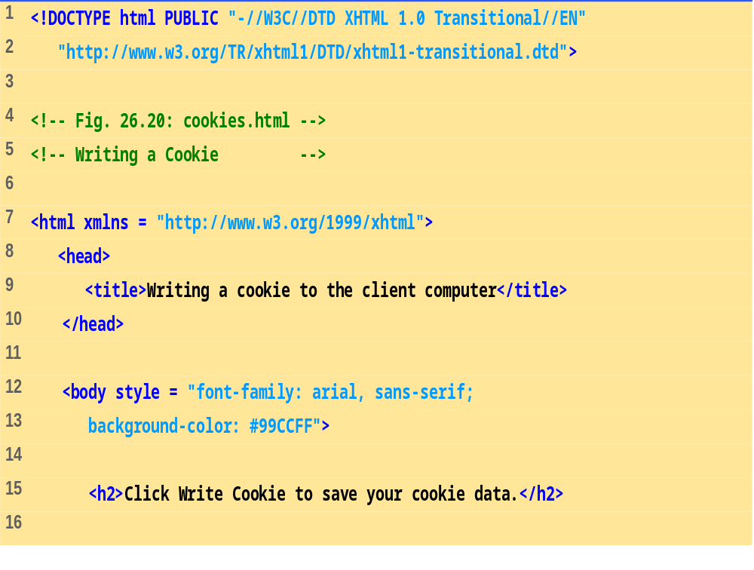
cookies.html
(1 of 2)

Slide 54
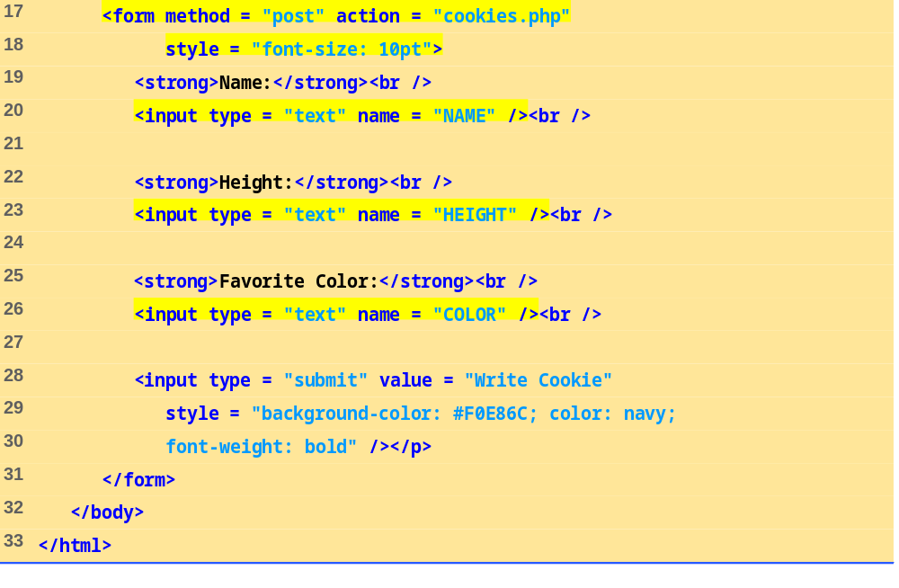

Slide 55
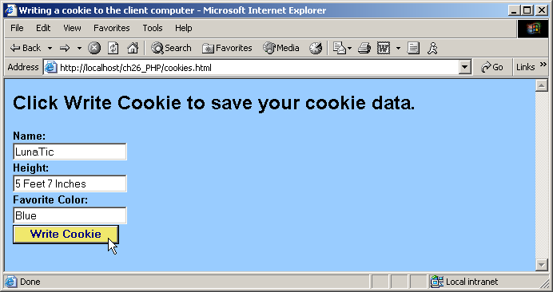
Cookies
Fig. 26.20 Gathering data to be written as a cookie.

Slide 56
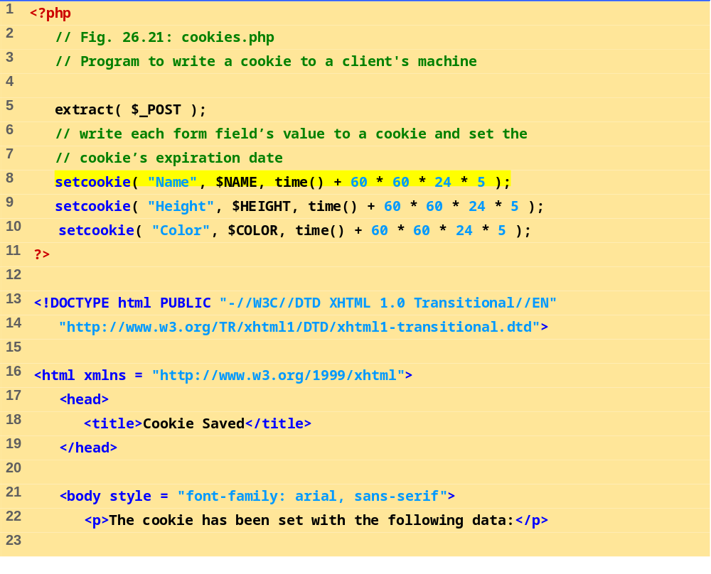
cookies.php
(1 of 2)
Function setcookie takes the name of the cookie to be set as the first argument, followed by the value to be stored in the cookie. The optional third argument specifies the expiration date of the cookie.

Slide 57
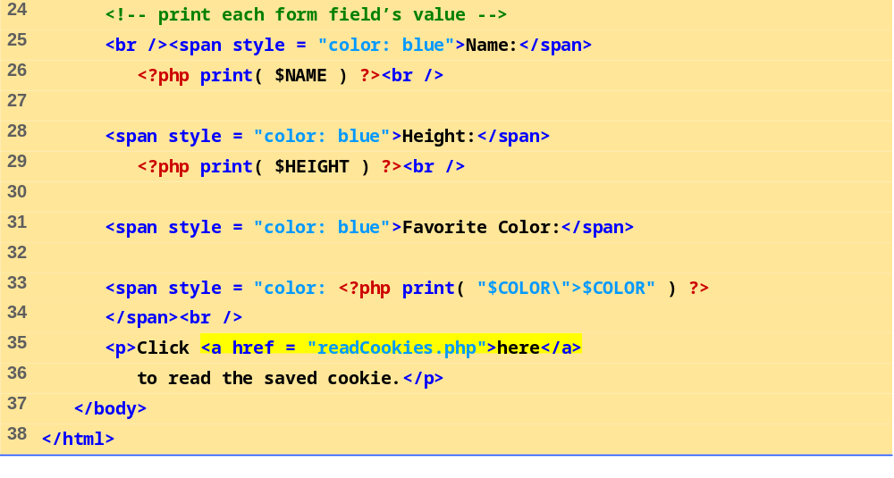
cookies.php
(2 of 2)
Each form field’s value is printed to confirm the data that has been set as a cookie with the user.
Hyperlink to readCookies.php.

Slide 58
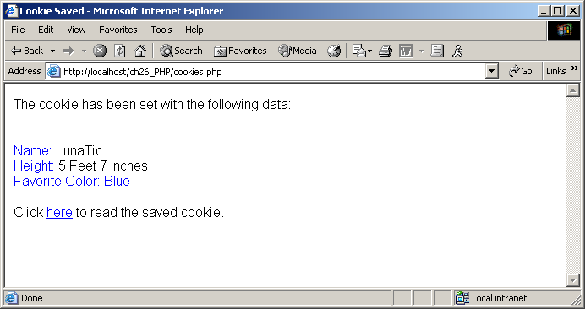
Cookies
Fig. 26.21 Writing a cookie to the client.

Slide 59
Cookies
Reading cookies
  $_COOKIE environment variable
    Array
  foreach loop to access each element
    Split into key and value

Slide 60
Cookies
Cookie storage
  Internet Explorer
    Stores cookies in Cookies directory
    Text file

Slide 61
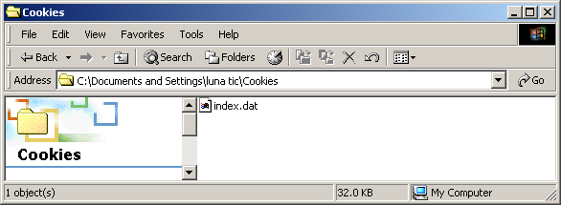
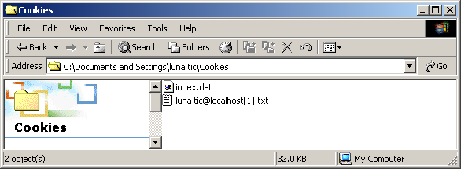
Cookies
Fig. 26.22 Cookies directory before a cookie is written.
Fig. 26.23 Cookies directory after a cookie is written.

Slide 62
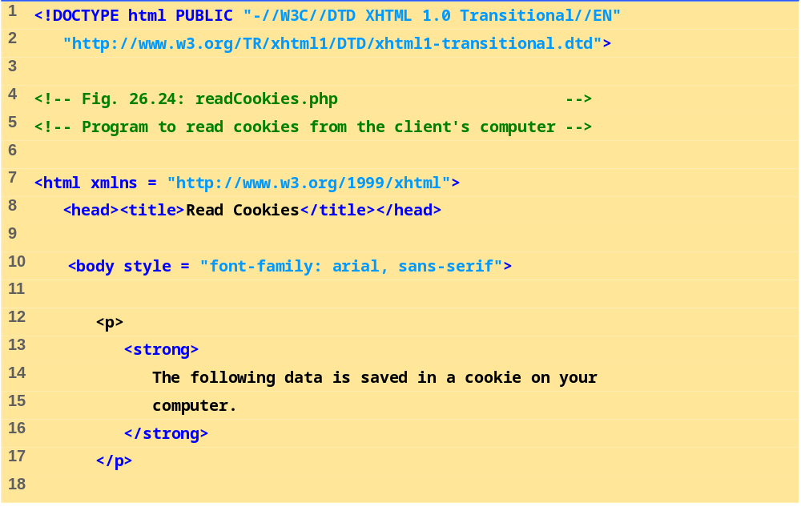
readCookies.php
(1 of 2)

Slide 63
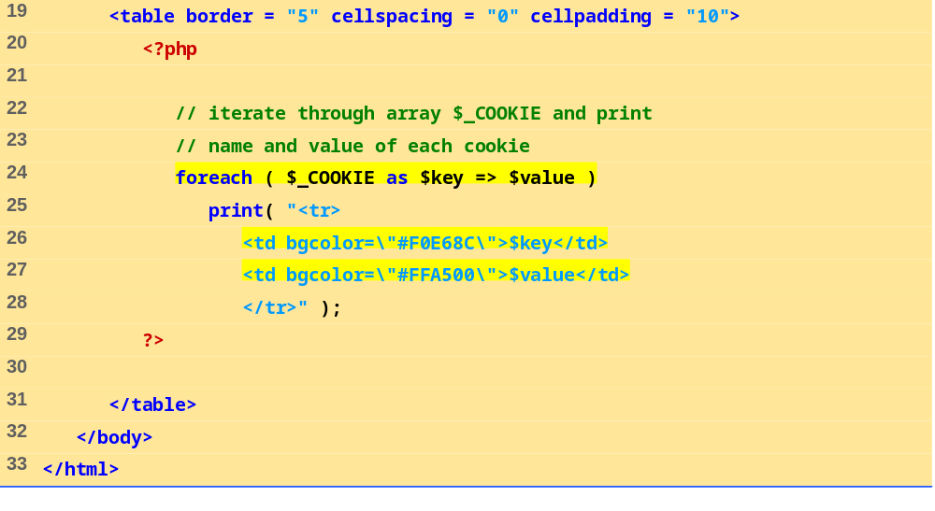
readCookies.php
(2 of 2)
The foreach loop iterates through the $_COOKIE array and prints the name and value of each cookie in an XHTML table.
PHP creates array $_COOKIE which contains all cookie values indexed by their names.

Slide 64
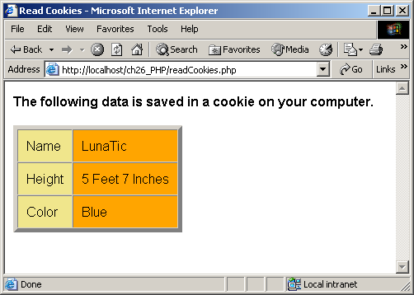
Cookies
Fig. 26.24 Displaying the cookie’s content.

Slide 65
Dynamic Content in PHP
Dynamically alter XHTML content
  Form’s action property set to same page that contains it
  Perform different actions when page is loaded and form is submitted
    isset variable
  Check for errors
    Write different XHTML when errors encountered
  $$variable syntax
    References variable whose name equals the value of $variable
  If input is valid, make MySQL database calls

Slide 66
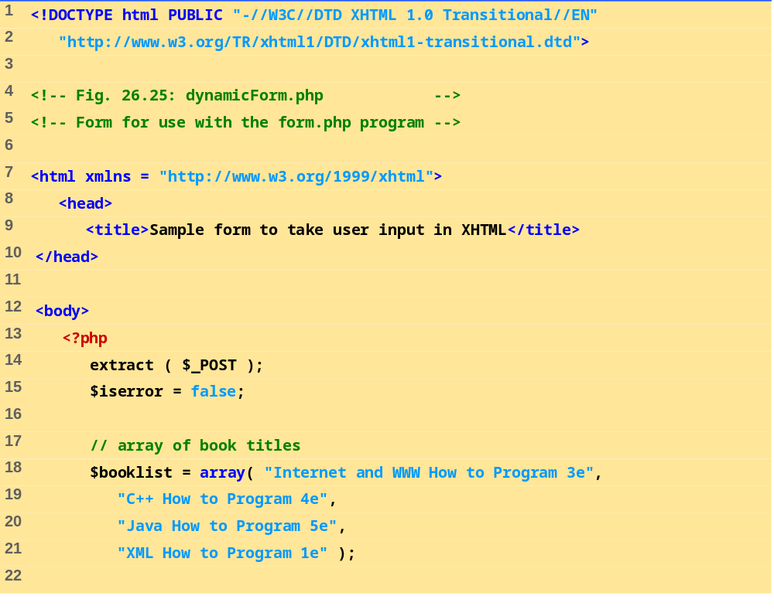
dynamicForm.php
(1 of 9)
Build array of options for the form.

Slide 67
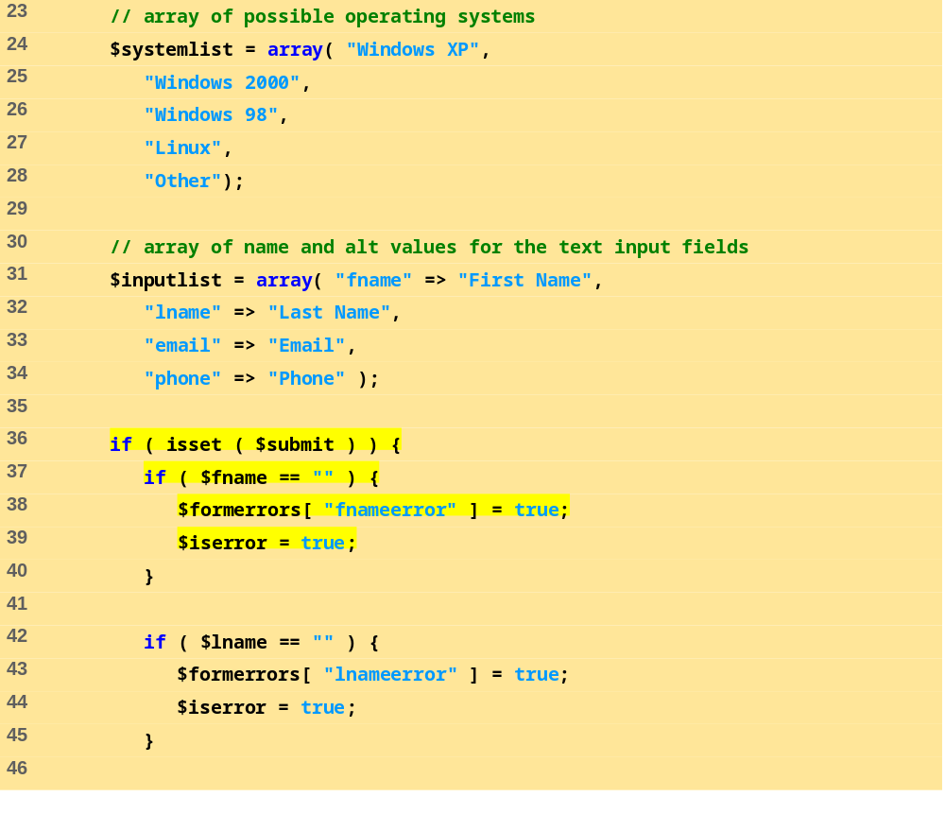
dynamicForm.php
(2 of 9)
If the page is being loaded as a result of a form submission, do error checking and then retrieve information from the database.
Check for errors or omissions in form field input.

Slide 68
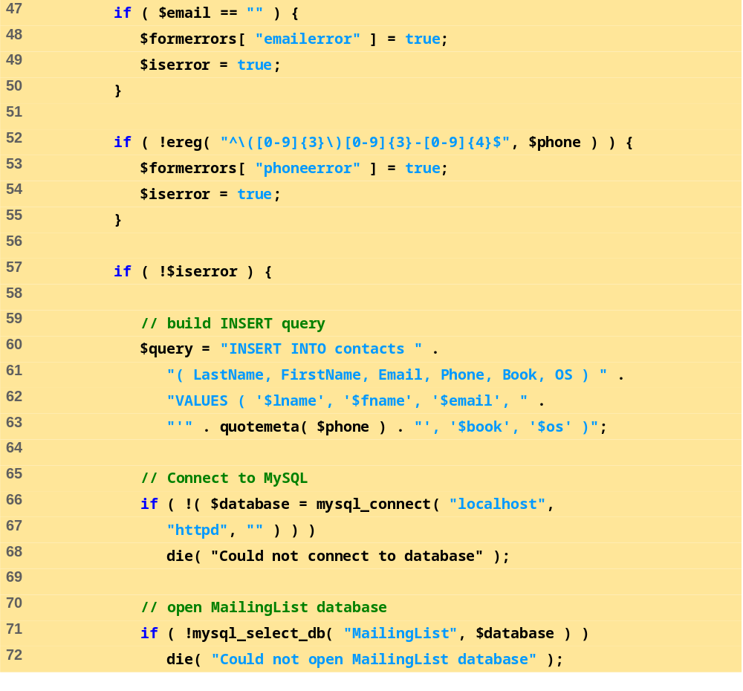
dynamicForm.php
(3 of 9)
If there were no errors, query the MySQL database.

Slide 69
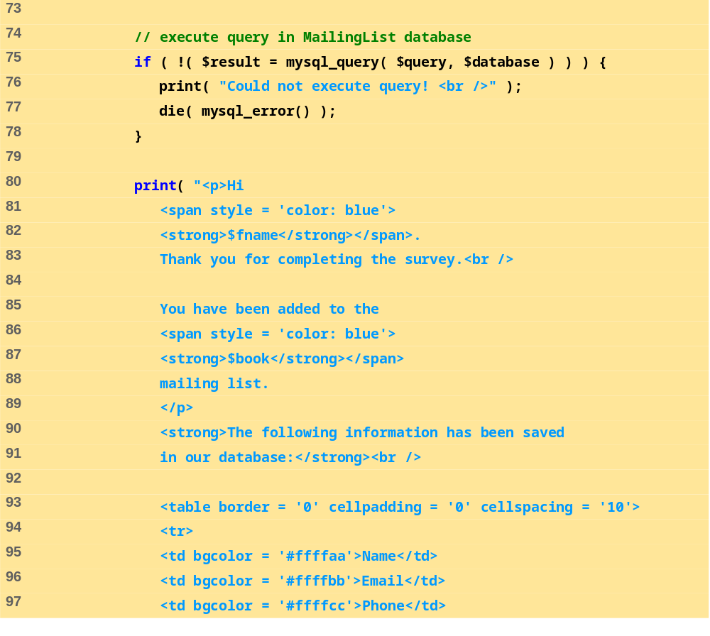
dynamicForm.php
(4 of 9)

Slide 70
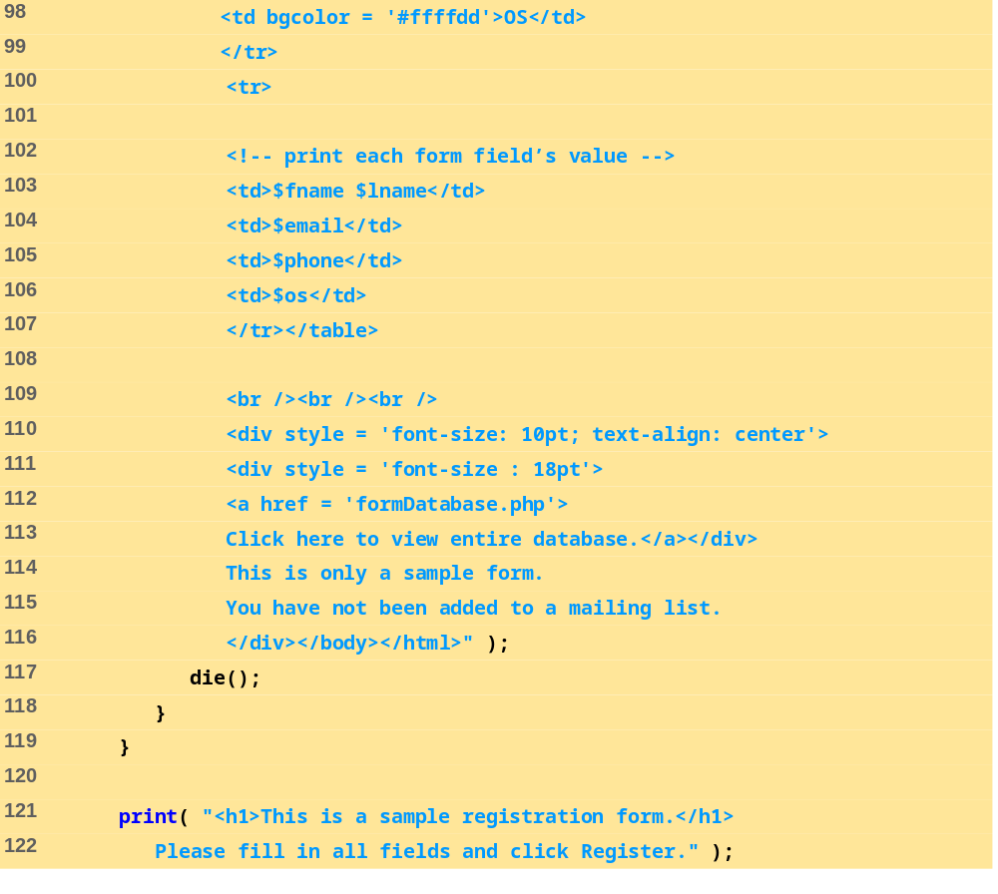
dynamicForm.php
(5 of 9)
Halt the script so the form-generation code does not execute.

Slide 71
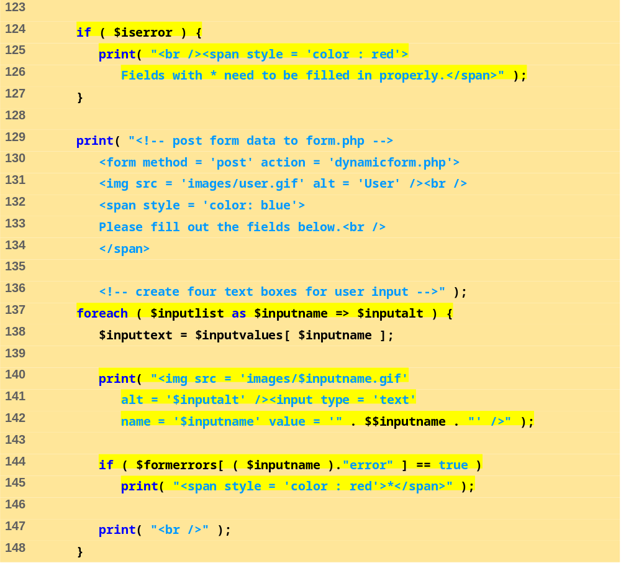
dynamicForm.php
(6 of 9)
Fill in the forms using $$variable syntax.
If the form input contained errors, place a red asterisk (*) next to the text field.

Slide 72
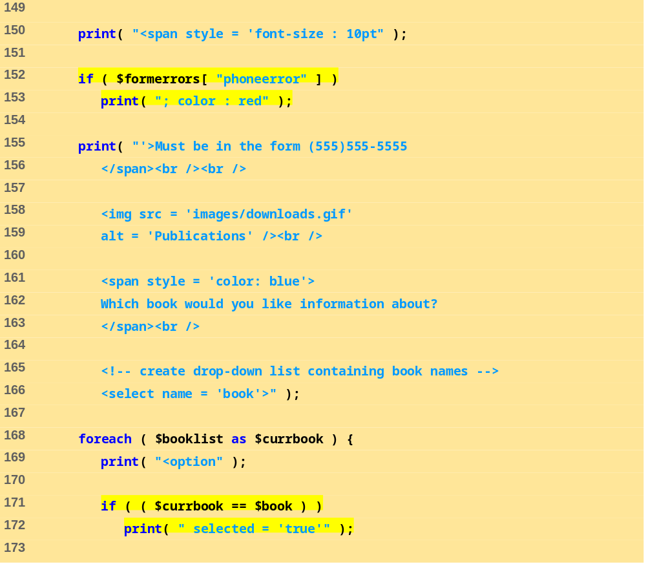
dynamicForm.php
(7 of 9)
Make sure the correct book is selected in the dropdown box.

Slide 73
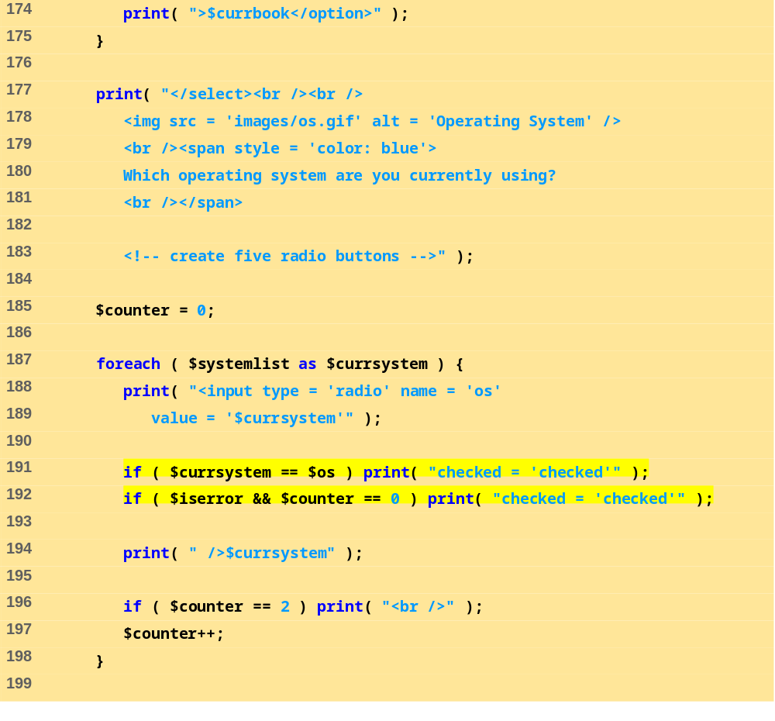
dynamicForm.php
(8 of 9)
Make sure the correct OS is checked in the checkbox.

Slide 74
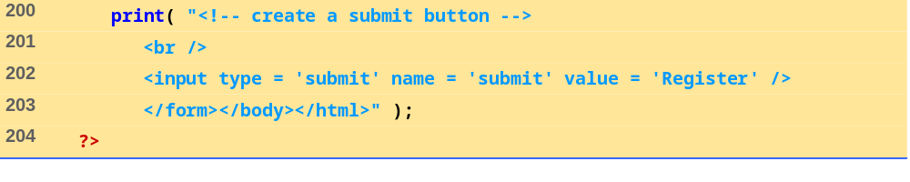
dynamicForm.php
(9 of 9)

Slide 75
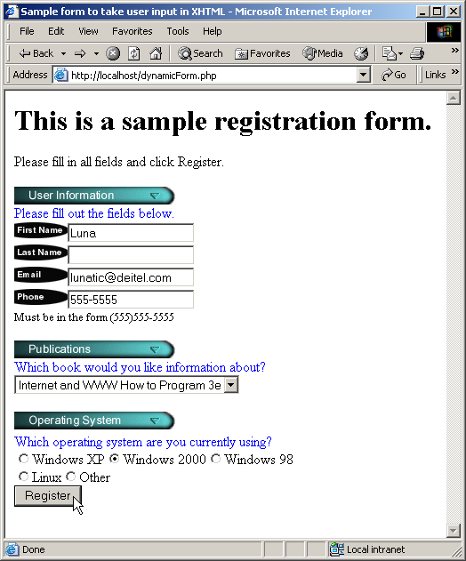
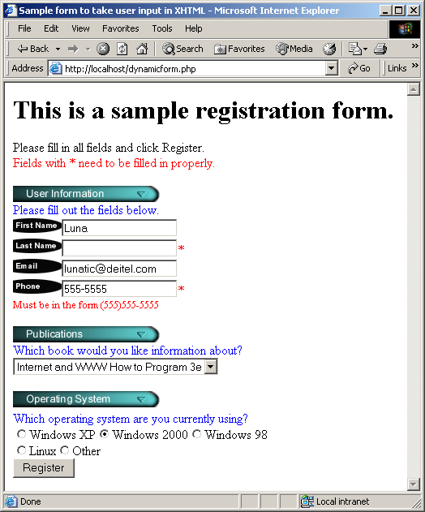
Dynamic Content in PHP
Fig. 26.25 Dynamic form using PHP.

Slide 76
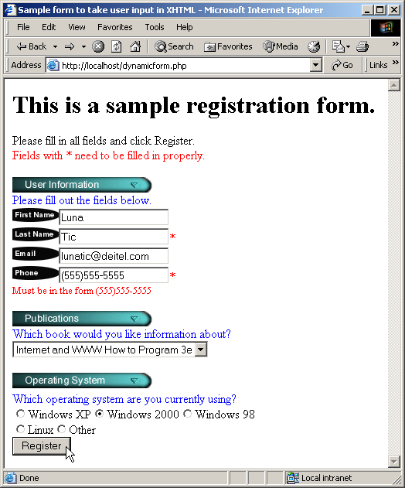
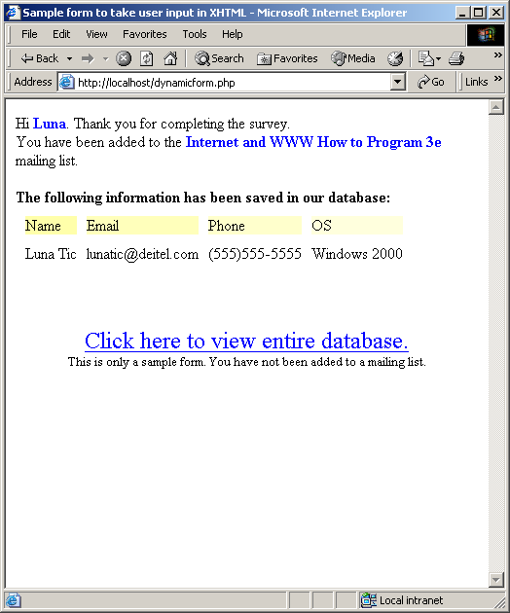
Dynamic Content in PHP
Fig. 26.25 Dynamic form using PHP.

Slide 77
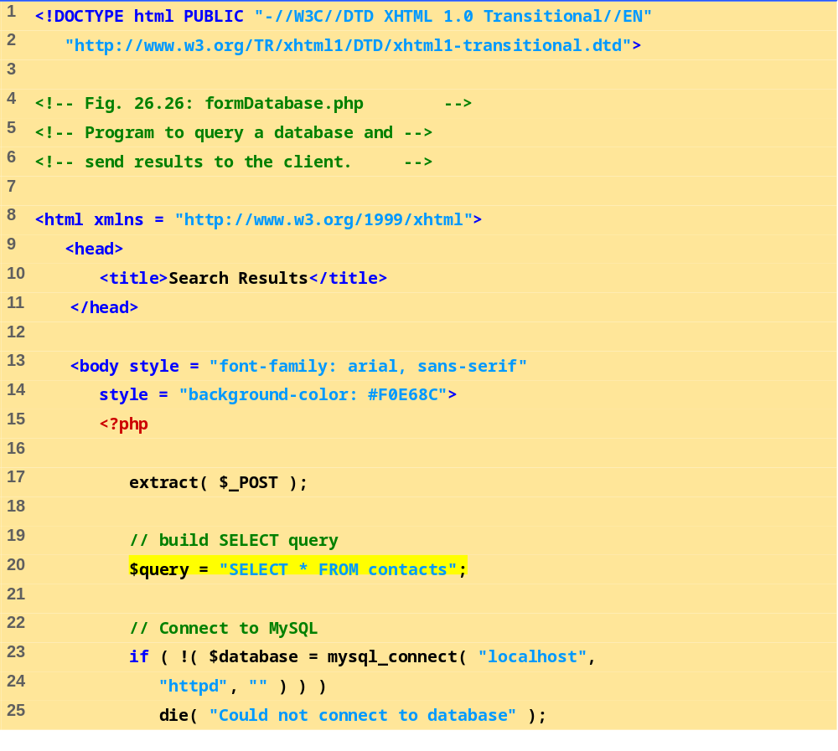
formDatabase.php
(1 of 3)
Build the query string.

Slide 78
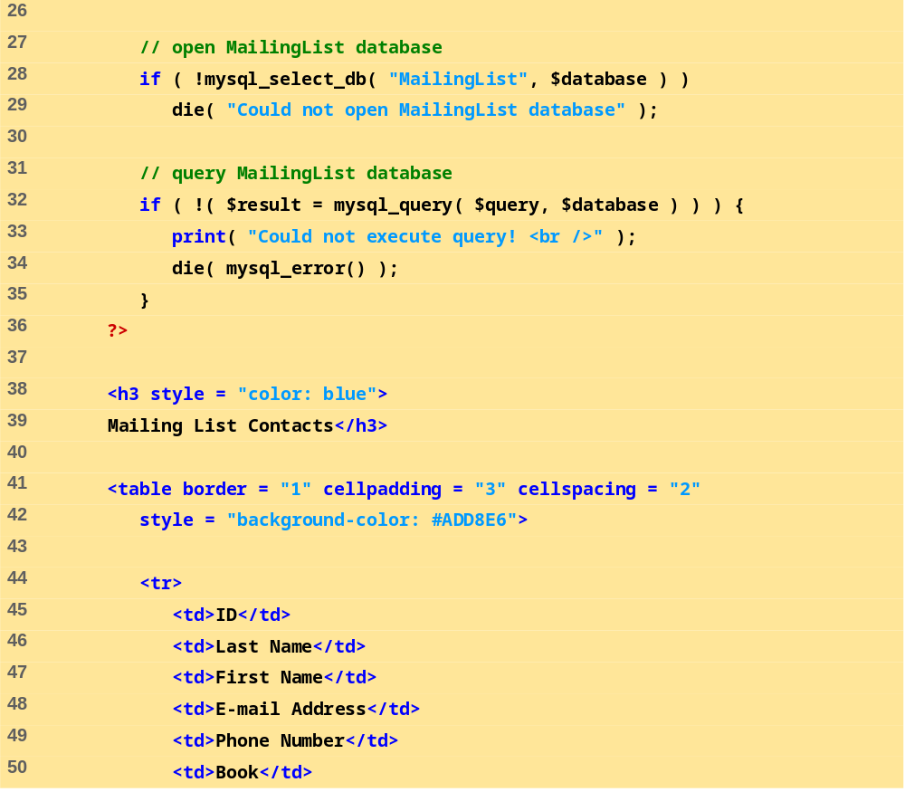
formDatabase.php
(2 of 3)

Slide 79
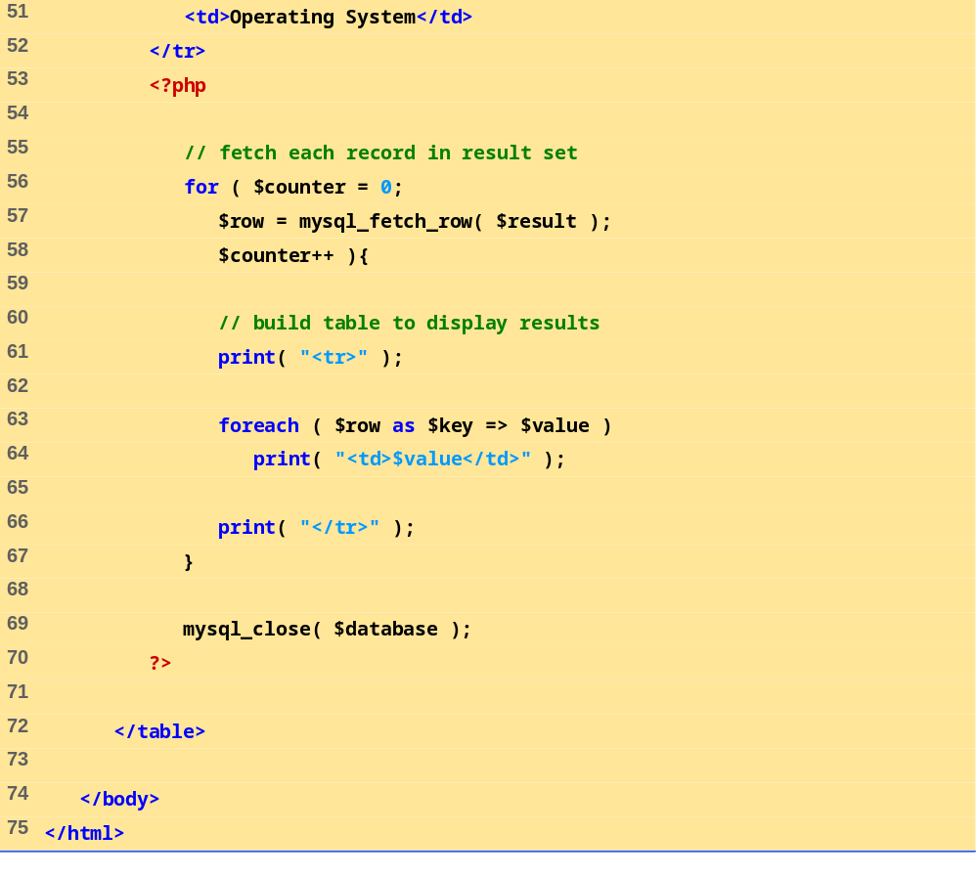
formDatabase.php
(3 of 3)
Retrieve each mailing list member record from the database.
Dynamically create a table containing each mailing list member.

Slide 80
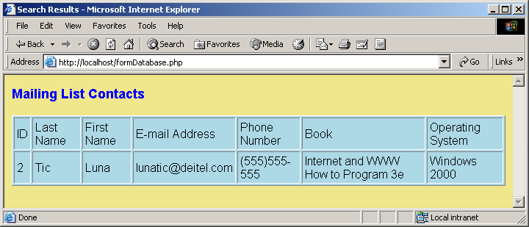
Dynamic Content in PHP
Fig. 26.26 Displaying the MailingList database.

